Slide 1
2023 - 2024 Financial Aid High School Presentation
New Jersey Higher Education Student
Assistance Authority

Slide 2
The Mission
The Higher Education Student Assistance Authority is the only State agency with the sole mission of providing students and families with the financial and informational resources to pursue their education beyond high school.
Financial Aid High School Presentation - 2
Notes:
HESAA Information Detailed:
Financial aid session
FAFSA Days
Booklets: State and Federal Aid, Financial Aid Dictionary, Student Loan Guide, and Reach Higher the College Planning Booklet.
Handouts: Eight Steps to Apply, Financial Planning Chart, and program brochures are available for free.
REAL $ 101 Financial Literacy on-site Sessions

Slide 3
Goals of Financial Aid Office
Primary goal is to assist students in paying for college and is achieved by:
Evaluating family’s ability to pay for educational costs
Distributing limited resources in an equitable manner
Providing a balance of gift aid and self-help aid
Implementing federal and state regulations for their college/university
Notes:
Gatekeepers of the financial aid funds.

Slide 4
Types of Aid
Help! Sources of Aid
Types of Financial Aid
Federal
State of New Jersey
The College/University
Outside Organizations
Civic organizations (ex.-local Rotary Club), parent’s employer, high school awards
Grants
Scholarships
Loans
Employment Opportunities

Slide 5
Net Price Calculator
All institutions must have a net price calculator posted on their websites.
Students will be able to estimate the individual net price per institution.
Based on full-time, first degree/certificate-seeking undergraduate students.
Notes:
HESAA also has on the website the NJEI calculator that calculates TAG for estimate purposes only.

Slide 6
Types of Aid - Federal
Gift Aid - Grants
Federal Government 2022 - 2023
Pell $6,895 (max award)
SEOG $4,000 (max award)
TEACH $3,772 (max award)
2023-2024 Award amounts are subject to change.
Notes:
Speaker Notes
PELL- SEOG
Named after senator Pell of Rhode Island, Pell is covered under the Higher Education Act of 1965
Pell is need based and all those with an EFC low enough are eligible so long as he or she has not received a first bachelor’s degree yet or are enrolled in a post baccalaureate program that leads to a teacher’s certification or licensure
Currently, the maximum amount is $5,920 and for 17 - 18. The amount of the award will depend on financial need, cost of attendance, and full time or part time status
The limit on Pell is 12 semesters in duration (roughly 6 years)
SEOG can range from $100 to $4000 – funding is provided by the US Department of Education to institutions to manage. Goes to most needy first and are very limited.
The TEACH Grant As a condition for receiving a TEACH Grant, you must sign a TEACH Grant Agreement to Serve in which you agree to (among other requirements) teach
in a high-need field
at an elementary school, secondary school, or educational service agency that serves students from low-income families
for at least four complete academic years within eight years after completing (or ceasing enrollment in) the course of study for which you received the grant.
Iraq and Afghanistan Service Grants
The Iraq and Afghanistan Service Grant is provided to certain students whose parent or guardian was a member of the U.S. armed forces and died as a result of military service performed in Iraq or Afghanistan after the events of 9/11. May not be eligible for a federal PELL Grant but must meet remaining eligibility requirements.
Max award for 17-18 after 10.1.17 is $5,529.28
https://studentaid.ed.gov/sa/about/announcements/sequestration#iraq-afghanistan

Slide 7
Types of Aid State Grants & Scholarships
TAG (Tuition Aid Grant)
File FAFSA or New Jersey Alternative Financial Aid Application
Demonstrate Financial Need
Be a U.S. citizen, eligible non-citizen or NJ Dreamer
Must be New Jersey Resident & attend a New Jersey Institution
Must be full time at an approved degree program
Meet all state deadlines
Part-Time TAG for County Colleges
Meet all TAG requirements
With the exception of being enrolled for 6-11 credits
Notes:
EOF (excellent program for financially and economically disadvantaged students)
EOF supports a wide array of campus-based outreach and support services to help program participants succeed and graduate
Benefits
Students enrolled in an EOF program receive financial assistance through semester grants ranging from $299 to $1,024. Family must have a documented history of financial and economic disadvantage - Some schools require that you are a first generation college student.
The amount of the grant varies depending upon financial need, cost of attendance and available funding. Awards are renewable annually based on continued eligibility.
Tuition Equity Law: DACA & Undocumented students - Complete the NJ Alternative Application if you are not a United States citizen or eligible noncitizen and meet all of the following criteria;
Attended a New Jersey high school for at least three (3) years
Graduated from a New Jersey high school or received the equivalent of a high school diploma in New Jersey
Registered for Selective Service (male students only)
Are able to file an affidavit stating that you will file an application to legalize your immigration status or will file an application as soon you are eligible to do so

Slide 8
Types of Aid State Grants & Scholarship
EOF (Educational Opportunity Fund)
Award ranges from $200 - $3,050 annually depending on type of institution
Must demonstrate educational and economically disadvantaged background
File FAFSA or New Jersey Alternative Financial Aid Application
Governor’s Urban Scholarship
Rank within the top 5% of their class at the end of junior year
Attain a 3.0 GPA at the end of the junior year
Attend an approved New Jersey college or University and reside in a designated community
File FAFSA or New Jersey Alternative Financial Aid Application
Have a New Jersey Eligibility Index below 10,500
Notes:
EOF (excellent program for financially and economically disadvantaged students)
EOF supports a wide array of campus-based outreach and support services to help program participants succeed and graduate
Must graduate from a traditional public, public charter, county vo-tech or nonpublic school and reside in any of the following townships
GUS - $1,000 annual award – top 5% of HS graduating class
Asbury Park City
Camden City
East Orange City
Irvington Township
Jersey City
Lakewood Township
Millville City
Newark City
New Brunswick City
Paterson City
Plainfield City
Roselle Borough
Trenton City
Vineland City

Slide 9
Types of Aid State Grants & Scholarship
NJ STARS
NJ residents who rank in the top 15% of their class at either the end of junior or senior year
Students must attain a cumulative GPA of 3.0 or higher at the start of the third semester at the county college to remain an NJ STAR
File a FAFSA or New Jersey Alternative Financial Aid Application
NJ STARS II
Received NJSTARS funding and have a family taxable income of less than $250,000
Must earn an associates degree and graduate with a 3.25 GPA or higher
May receive up to $2,500 annually for a public or private 4-year NJ college or university
Must take at least 12 college credits or 6 credits with a qualified doctors note
File a FAFSA or New Jersey Alternative Financial Aid Application
Notes:
Governor Christie signed Public Law 2012, Chapter 8 (PL 2012, c.8) into law on May 2, 2012 amending the NJ STARS and NJ STARS II Programs to make them more sustainable.
Limits the amount of the NJ STARS scholarship to tuition only. Budgetary footnote language has limited NJ STARS awards to tuition only since fall 2010 for new program participants.
Eligibility requirements are unchanged.
Must graduate in the top 15.0% of their high school graduating class.
NJ STARS-eligible students must file a FAFSA and complete the State grant record within established State deadlines.
Students may be eligible to receive NJ STARS awards for up to five semesters. Funds are not available to cover summer payments.
NJ STARS-eligible high school graduates may receive awards based on tuition only, after deducting any other federal and/or State grants and scholarships.
Students must attain a minimum cumulative grade point average (GPA) of 3.0 or higher at the start of the third semester of county college enrollment to remain eligible for NJ STARS. Summer courses are included in determining the cumulative GPA.
Students must maintain continuous full-time enrollment unless on a medical leave that is approved by the county college prior to the completion of the semester for which the leave is being granted.
NJSTARS II
Eligibility Requirements as follows:
Earn an associate degree from their home New Jersey county college as an NJ STARS recipient. Must graduate with a cumulative GPA of 3.25 or higher.
Family income (taxable and untaxed income) must be less than $250,000 as derived by the FAFSA
Meet all other program eligibility requirements, including admission into a baccalaureate program at a New Jersey four-year public or private college or university that participates in the TAG program
Complete a FAFSA and the State grant record within established State deadlines
NJ STARS II benefits for non-renewal students were changed by Bill PL 2012, c.8
Non-renewal NJ STARS II students may receive up to $1,250 per semester, paid completely by the State, after all other sources of federal and State grants and scholarships are applied to tuition charges.
Open to all four-year TAG-participating institutions-public or private

Slide 10
Types of Aid State Grants & Scholarships
Governor’s Industry Vocation Scholarship for Women & Minorities (NJ - GIVS)
Up to $2,000 per year for the cost of enrollment at one of New Jersey’s 18 County Colleges, Technical / Vocational Schools, some Proprietary Schools
Benefits women and minorities pursuing certificate or degree programs in construction – related fields
Must be NJ resident and have AGI < $60,000
File FAFSA or New Jersey Alternative Financial Aid Application
Complete separate application online at www.njgrants.org
Some of the programs eligible for the scholarship include
Construction Supervision
Solar Energy Technology
Architectural Engineering Technology
Notes:
Complete an NJ – GIVS application at njgrants.org
Eligible certificate or degree program

Slide 11
Types of Aid – State (cont.)
Community College Opportunity Grant (CCOG)
Covers tuition and fees minus all other grants and scholarships
AGI between $0 - $65,000 for maximum award
AGI between $65,001 - $80,000 pays up to 50% of the maximum CCOG award
Must be NJ resident attending a county college
File FAFSA or New Jersey Alternative Financial Aid Application
Minimum 6 credits per semester
Make Satisfactory Academic Progress as defined for CCOG
Must have a complete State grant record
Notes:
Complete an NJ – GIVS application at njgrants.org
Eligible certificate or degree program

Slide 12
Garden State Guarantee
New Jersey State Colleges and Universities
Available for students in their third and fourth years of enrollment
Tuition and Approved Fees free for AGI between $0 - $65,000
Students with AGI’s between $65,001 - $80,000 will pay a discounted net price of no more than $7,500 for tuition and fees
Guaranteed pricing structure for all students throughout their academic program
Must be NJ resident attending a New Jersey public college or university
File FAFSA or New Jersey Alternative Financial Aid Application
Make Satisfactory Academic Progress
Notes:
Complete an NJ – GIVS application at njgrants.org
Eligible certificate or degree program

Slide 13
3 + 1 Degree Completion Programs
Student enrolls in a bona fide 3 + 1 major/degree program
Student completes the first two years at the community college and earns an Associate Degree
Pays community college tuition and fees for the associate degree and the third year of their program
Attends and pays the four-year institution tuition and fees in the final year
File FAFSA or New Jersey Alternative Financial Aid Application
Meet all other eligibility criteria for TAG, NJSTARS, CCOG

Slide 14
Self Help Loans & Gap Shortfall Solutions
Monthly Payment Plans – offered by the college
Federal Direct Loan Program (1st year dependent student)
Subsidized Loan $3,500 need based
Unsubsidized Loan $2,000 additional
2022 - 2023 - Federal Direct Undergraduate Direct Loans are 4.99% plus a 1.057% origination fee
2023 – 2024 Rates and fees are subject to change
Notes:
Graduate Stafford loans are now 6%

Slide 15
Self Help Loans to Cover the Gap borrow up to cost of attendance
2022 - 2023 - NJCLASS Supplemental Loan Program
10 Year Fixed Rate NJCLASS LOAN, starting at 3.75%
15 Year Fixed Rate NJCLASS LOAN is 5.30%
20 Year Fixed Rate NJCLASS LOAN is 6.75%
All options have a 3% origination fee
Federal PLUS Program 7.54% with a 4.228% origination fee
Origination fee, Parent is the borrower
2023 – 2024 Rates and fees are subject to change
Notes:
We also offer consolidation programs & a ReFi program that
Consolidation extends the repayment term to 25 – 30 depending on loan balance and takes the weighted average of the loans minus a tiny percentage
The ReFi program is a 10 year repayment term and is based on income, credit score and debt to income ratio (depending on credit score the APR will range from 4.90% to 6.90%
HESAA also now has a Repayment Assistance Program (RAP), which is designed to provide payment relief when all parties of the loan are facing financial hardship
During the RAP period, a payment on eligible NJCLASS loan shall be reduced to 10% fo the total of the household income of all of the parties to the loan that exceeds 150& of the federal poverty guidelines for their family size, with a minimum monthly payment of $5 per eligible loan
Interest that accrues during RAP will be paid by HESAA
RAP is available for NJCLASS loans with applications that were received on or after June 1, 2017 or are to be used for an academic term that begins on or after August 1, 2017
HESAA now also discharges the loan obligation for all parties to a NJCLASS loan in the event of death or total and permanent disability of the student beneficiary

Slide 16
Institutional & Private Scholarships
Factors that may influence eligibility:
Academics | Athletic Ability*
SAT’s | Geographic Diversity
AP Courses | Legacy (child of alumni)
Activities | Talent
Academic Track | Gender/Ethnicity
H.S. Attended | Class Rank
* Athletic awards offered by NCAA Division I and Division II schools only.

Slide 17
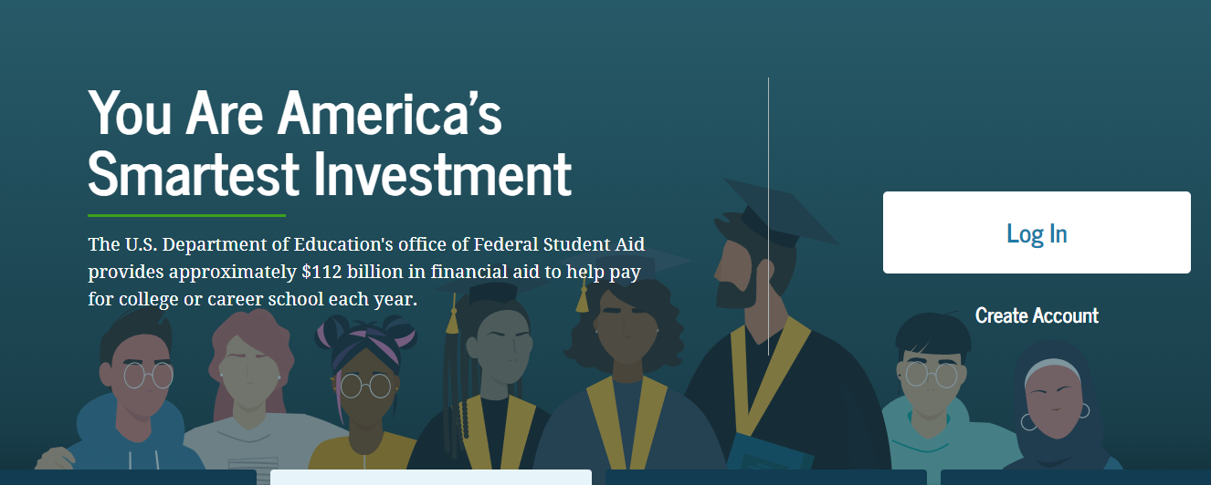
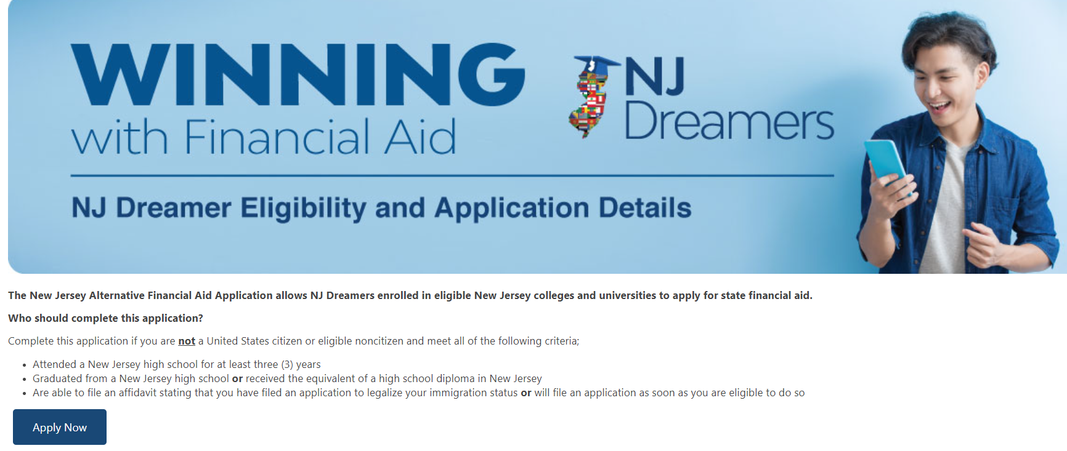
Applications to Access Aid
studentaid.gov
student.collegeboard.org/profile
HESAA.org
Notes:
Jules / Sharon – please add screen shot for alt app

Slide 18
Application: CSS Profile
Approximately 400 Colleges and Organizations use the CSS profile to determine how they will award institutional funds
Available 10/1 each year and collects more comprehensive income, asset and household information than the FAFSA (i.e. assets for business owners regardless of number of employees)
Aligns with the FAFSA’s use of prior - prior year income (2021 for 2023-2024)
Register - Complete Application – Make payment – Submit
No payment for income under $100,000
All others, $25 for first application and $16 for each additional
Notes:
Check out http://student.collegeboard.org/profile for a list of institutions that require CSS profile
CSS profile uses institutional methodology formula whereas FAFSA uses federal methodology
The CSS profile is a fee based application. The cost for filing the CSS PROFILE is $25 for the first college, and there is an $16 processing fee for each additional college. This is not the FAFSA. The FAFSA is free.
Can take 45 minutes to 2 hours to complete
Can leave some answers blank but an error will prompt if answer is required but most numeric questions at least require a zero

Slide 19
CSS Profile
Website to apply for profile
https://cssprofile.collegeboard.org/
Website to apply for Noncustodial Profile:
https://www.proprofs.com/training/course/?title=202223-completing-the-css-profile-for-noncustodial-parent_610a90e612320
Customer Support
844-202-0524
Live Chat Available
19

Slide 20
Free Application for Federal Student Aid (FAFSA)
2023-2024 FAFSA available October 1, 2022
Collects family’s personal and financial information used to calculate the student’s Expected Family Contribution
File the FAFSA electronically via FAFSA on the Web at www.studentaid.gov
FAFSA Uses prior prior year income information (2021)
Use the IRS Data Retrieval Tool to populate income & tax information with actual prior - prior year tax information
All prior prior year tax information (2021) is already filed, allowing immediate retrieval.
Notes:
8
You should use the IRS DRT at the time of filing the initial FAFSA. Using this tool will automatically verify your information for federal

Slide 21
Federal Student Aid ID
Student & one parent must create a Federal Student Aid ID (FSA ID) at www.studentaid.gov by clicking on ‘create account
In order to enhance security, FSA ID requires a two step verification. Customers will use their username and password (FSA ID) and will also need to provide a secure code that is provided to the user by text, email, or through an authenticator app each time they log in
If you are a parent of a dependent student, you will need your own FSA ID
All parties must be verified by a mobile phone number or email when creating the FSA ID
Notes:
The FSA id is a higher security login which will connect the student and parent to the FAFSA. The FSA id will also connect the student to the federal student aid website, and the National student loan data base.

Slide 22
IRS Data Retrieval Tool
The IRS data retrieval tool or (DRT) is used to transfer tax return information into the FAFSA
The DRT will be available beginning October 1st to support early FAFSA
Tax filers who file Married filing separately and foreign tax returns cannot use DRT
Amended tax returns – original tax data will be transferred

Slide 23
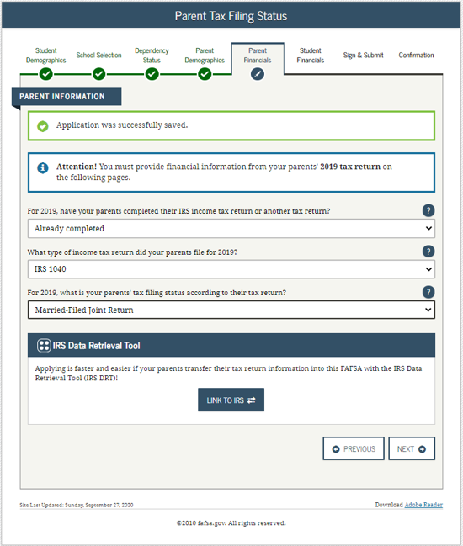
Notification of Which Tax Year to Use
Applicants and parents will be instructed to provide financial information from their 2021 tax return
2021
2021
2021
2021
Notes:
When filing the FAFSA this coming ay, students & families will see 2016 obviously not 2015

Slide 24
General Highlighted Eligibility Requirements for FAFSA
Must have a valid Social Security Number
Must be enrolled or accepted for enrollment in an eligible program of study
Must be pursuing a degree, certificate, or other recognized credential
Must be a U.S. citizen or eligible noncitizen
Notes:
If you are an eligible noncitizen, write in your eight- or nine-digit Alien Registration Number. Generally, you are an eligible noncitizen if you are (1) a permanent U.S. resident with a Permanent Resident Card (I-551); (2) a conditional permanent resident with a Conditional Green Card (I-551C); (3) the holder of an Arrival-Departure Record (I-94) from the Department of Homeland Security showing any one of the following designations: “Refugee,” “Asylum Granted,” “Parolee” (I-94 confirms that you were paroled for a minimum of one year and status has not expired), T-Visa holder (T-1, T-2, T-3, etc.) or “Cuban-Haitian Entrant;” or (4) the holder of a valid certification or eligibility letter from the Department of Health and Human Services showing a designation of “Victim of human trafficking.”
If you are in the U.S. on an F1 or F2 student visa, a J1 or J2 exchange visitor visa, or a G series visa (pertaining to international organizations), select “No, I am not a citizen or eligible noncitizen.” You will not be eligible for federal student aid. If you have a Social Security Number but are not a citizen or an eligible noncitizen, you should still complete the FAFSA because you may be eligible for state or college aid.
The Selective Service System and the registration requirement for your men, preserves America’s ability to provide manpower in an emergency to the US armed forces Almost all men ages 18 to 25 must register. For more information please visit 222.sss.gov

Slide 25
Key Components of the FAFSA
Student Demographics
Full Name
Social Security Number
Date of Birth
NJ applicants must provide an answer to the driver’s license questions
Student Income and Assets
IRS Data Retrieval
Income earned from work
Student Status: Dependent/Independent
Parent Demographics-Who is a Parent?
Social Security Number
Last Name
Date of Birth
Notes:
6
WHO IS THE PARENT
If your parent was never married and does not live with your other legal parent, or if your parent is widowed or not remarried, answer the questions about that parent.
• If your legal parents (biological and/or adoptive) are not married to each other and live together, select “Unmarried and both parents living together” and provide information about both of them regardless of their gender. Do not include any person who is not married to your parent and who is not a legal or biological parent. Contact 1-800-433-3243 for assistance in completing questions 80-94.
• If your parents are married, select “Married or remarried.” Consistent with the Supreme Court decision holding Section 3 of the Defense of Marriage Act (DOMA) unconstitutional, same-sex couples must report their marital status as married if they were legally married in a state or other jurisdiction (foreign country) that permits same-sex marriage, without regard to where the couple resides. If your legal parents are divorced but living together, select “Unmarried and both parents living together.” If your legal parents are separated but living together, select “Married or remarried,” not “Divorced or separated.”
• If your parents are divorced or separated, answer the questions about the parent you lived with more during the past 12 months. (If you did not live with one parent more than the other, give answers about the parent who provided more financial support during the past 12 months or during the most recent year that you actually received support from a parent.) If this parent is remarried as of today, answer the questions about that parent and your stepparent.
• If your widowed parent is remarried as of today, answer the questions about that parent and your stepparent.

Slide 26
Key Components of the FAFSA (cont.)
Household Size
Number in college
Parent(s) Income and Assets
IRS Data Retrieval
Income earned from work
Dislocated Worker
Federal Means Tested Benefits
Medicaid, SSI, SNAP, Free or Reduced Price School Lunch, TANF, WIC
SNAP is now available for College Students
List all colleges of interest (up to 10)
Notes:
6
# in College
Always count yourself as a college student. DO NOT Include your Parents. Include others only if they will attend, at least half-time in 2015-2016, a program that leads to a college degree or certificate.
ASSETS
Net worth means current value minus debt. If net worth is negative, enter 0.
Investments include real estate (do not include the home in which you live), rental property (includes a unit within a family home that has its own entrance, kitchen, and bath rented to someone other than a family member), trust funds, UGMA and UTMA accounts, money market funds, mutual funds, certificates of deposit, stocks, stock options, bonds, other securities, installment and land sale contracts (including mortgages held), commodities, etc.
Investments also include qualified educational benefits or education savings accounts (e.g., Coverdell savings accounts, 529 college savings plans and the refund value of 529 prepaid tuition plans). For a student who does not report parental information, the accounts owned by the student (and/or the student’s spouse) are reported as student investments in question 42. For a student who must report parental information, the accounts are reported as parental investments in question 91, including all accounts owned by the student and all accounts owned by the parents for any member of the household.
Money received, or paid on your behalf, also includes distributions to you (the student beneficiary) from a 529 plan that is owned by someone other than you or your parents (such as your grandparents, aunts, and uncles). You must include these distribution amounts in question 45j.
Investments do not include the home you live in, the value of life insurance, retirement plans (401[k] plans, pension funds, annuities, non-education IRAs, Keogh plans, etc.) or cash, savings and checking accounts already reported in questions 41 and 90.
Investments also do not include UGMA and UTMA accounts for which you are the custodian, but not the owner.
Investment value means the current balance or market value of these investments as of today. Investment debt means only those debts that are related to the investments.
Business and/or investment farm value includes the market value of land, buildings, machinery, equipment, inventory, etc. Business and/or investment farm debt means only those debts for which the business or investment farm was used as collateral.
Business value does not include the value of a small business if your family owns and controls more than 50 percent of the business and the business has 100 or fewer full-time or full-time equivalent employees. For small business value, your family includes (1) persons directly related to you, such as a parent, sister or cousin, or (2) persons who are or were related to you by marriage, such as a spouse, stepparent or sister-in-law.
Investment farm value does not include the value of a family farm that you (your spouse and/or your parents) live on and operate.

Slide 27
Click to Apply for State Aid
2023 - 2024
New Jersey State based
This link redirects filers to view instructions regarding the NJFAMS Student Portal. Applicants are instructed to log into “NJFAMS.HESAA.org” to create a user ID and password. In 3-5 business days, students can their check awards and eligibility status and complete any outstanding items on their “To Do” list (There is no State Application only a To-Do-List).
Please note, all notifications will be sent to the student email address listed on the FAFSA.

Slide 28
Common Mistakes Made on the FAFSA
Student’s name as it appears on the social security card, social security number, and date of birth.
Parent section vs. Student section
Number of people in the household
Divorced/remarried households
Taxes paid vs. taxes withheld
Including untaxable social security benefits
Parental and student assets
“Zero” is a number
College grade level
Filing an application for the incorrect academic year
Filing the wrong application based on student immigration status
Notes:
6

Slide 29
Federal & State Verification
Students are randomly selected, however, using the IRS DATA Retrieval Tool will reduce the likelihood of being selected
SCHOOL is responsible for verifying information for federal aid except for special circumstances
HESAA is responsible for verifying information for State aid
Schools may send request for information by mail or e-mail
Always check your school account and NJFAMS account for required tasks
Be sure to meet verification deadlines
Notes:
6

Slide 30
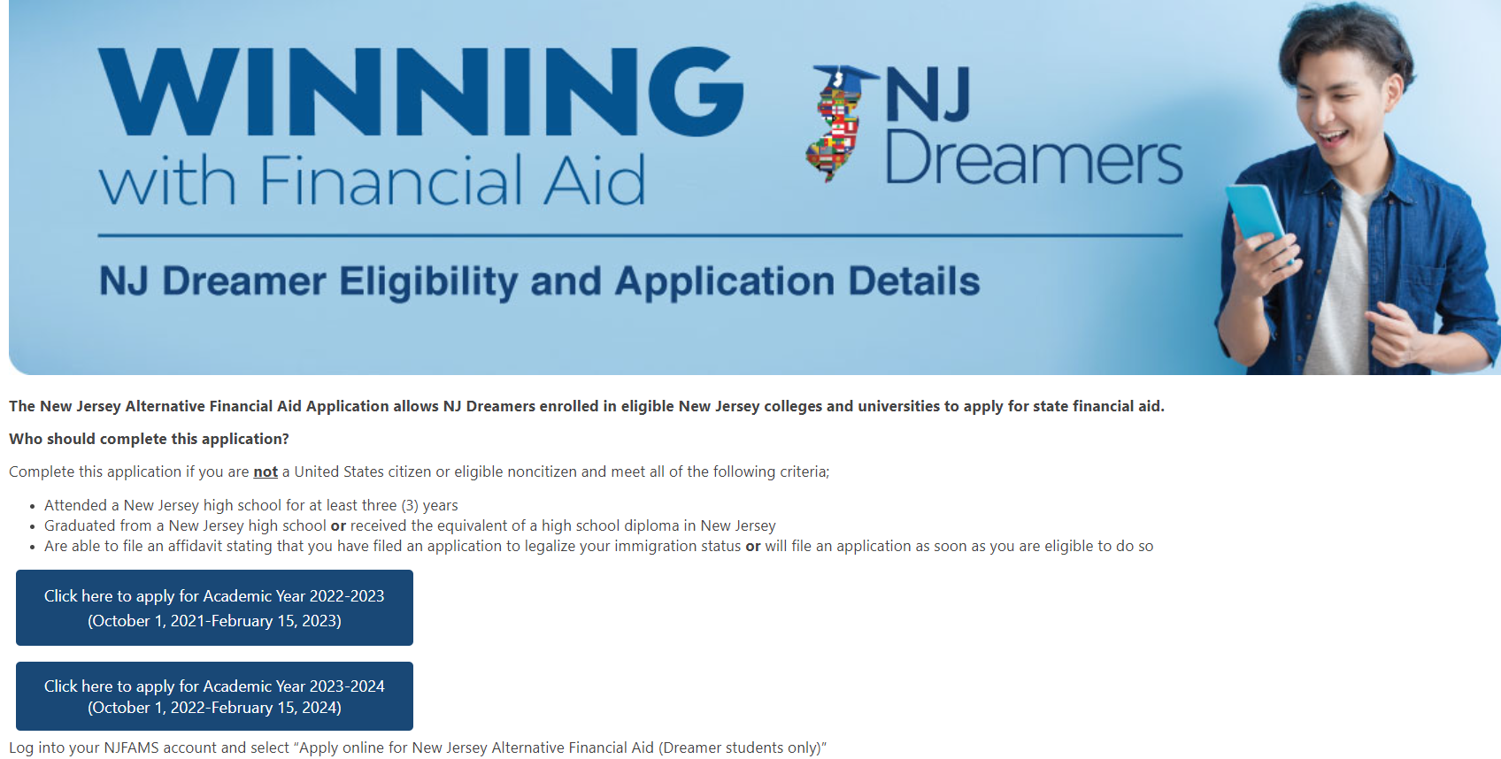
New Jersey Dreamers
All students must go to NJFAMS.HESAA.org
Register for your account by creating a User ID and Password
Log in to complete the application by established deadlines.
Notes:
Jules / Sharon – add pic of NJFAMS login slide from NJGRANTS

Slide 31
NJFAMS
All students must go to “NJGRANTS.org”
Establish an NJFAMS Account by creating a User ID and Password
Notes:
Jules / Sharon – add pic of NJFAMS login slide from NJGRANTS

Slide 32
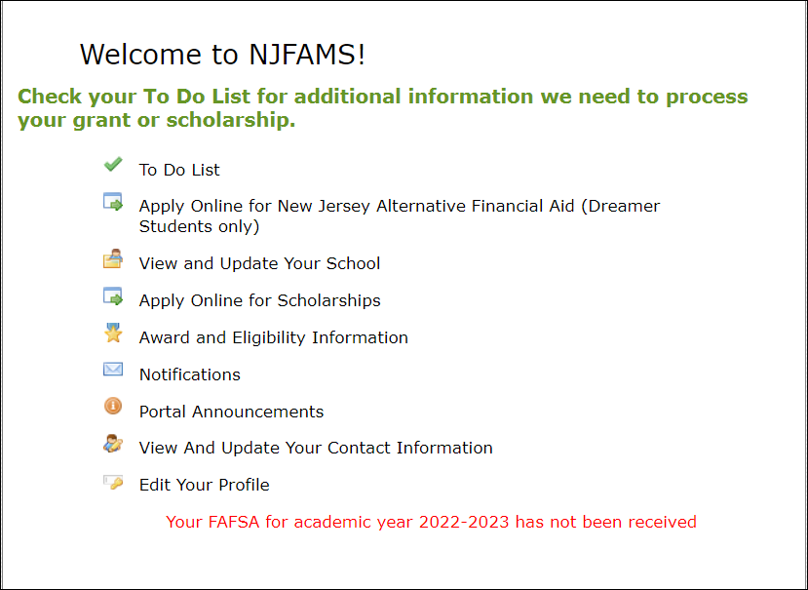
NJFAMS
Your FAFSA for academic year 2023-2024 has been received
Your FAFSA for academic year 2022-2023 has not been received
Notes:
Jules / Sharon – add pic of NJFAMS login slide from NJGRANTS

Slide 33
Cost of Attendance
Tuition and fees
Room and board
Books and supplies, equipment, transportation, and miscellaneous personal expenses
Loan fees
Study abroad costs
Dependent care expenses
Expenses related to a disability
Expenses for cooperative education program
Notes:
6

Slide 34
Unexpected Costs
Remediation Classes: extra 1 – 2 semesters
Change in major: 1 – 2 years in addition
Transferring: possible extra semester
Unpaid internships: loss of Summer wages
Study Abroad, Spring break, trips home and pledging costs
Moving expenses and Summer storage
34

Slide 35
What Is The Expected Family Contribution (EFC)?
Basis of financial aid package
EFC is determined by a federal formula that calculates need using the information you supplied on the FAFSA
EFC & Financial Need are guidelines used by schools to determine an aid package
EFC is not necessarily equal to a family’s out-of-pocket costs

Slide 36
Sample EFC for Smith Family
Family lives in New Jersey
Married parents
Household size of 4 with 1 child going to college
2020 adjusted gross income = $99,000
Assets = $15,000
Student income / assets = $0
EFC = 15000
36

Slide 37
Financial Need for Smith Family
College | Community College | State College or University | Private College or University
COA | $8,000 | $30,000 | $60,000
EFC | $15,000 | $15,000 | $15,000
Financial Need | 0 | $15,000 | $45,000
37
Notes:
All examples include approximate tuition, fees (left out new student fee), room and board for academic year.

Slide 38
The Cycle of Financial Aid
Oct - March | Complete FAFSA application, college search, college application process, and CSS Profile
February - May | Schools send award letters
June - July | School sends Fall Semester bill
Notes:
CSS Profile is essential for some colleges institutional aid.

Slide 39
Where Do I Go From Here?
Obtain and review admission, financial aid materials and deadlines from each school to which you are applying
Meet all application deadlines
CSS Profile if applicable
Complete the FAFSA and any other application materials required by the school or your state agency - NJ State deadlines are:
TAG Renewal Students – April 15, 2023 preceding the academic year for which aid is requested
All Other Applicants – September 15, 2023 for Fall and Spring term awards; February 15, 2024 for Spring awards only
Notes:
Deadlines for completing state grant records (tasks, verification, corrections etc…) are on our website as well as deadlines for college code changes, updates, additions and deadlines

Slide 40
Other Resources
Outside Scholarships
Campus Administered Payment Plans
Campus Employment
Specialized Campus Opportunities
Residential Advisors
Student Ambassadors
Student Tour Guides
Internships/CO-OP’S

Slide 41
Private Scholarship Search
Institution/college web sites
Local library resources
Local businesses, civic organizations and churches
Check with your High School guidance office
Parent’s employer(s)
www.hesaa.org
www.fastweb.com
www.collegeboard.org
www.mappingyourfuture.org

Slide 42
NJBEST College Savings Plan
NJBEST is the only 529 Savings Plan to award a scholarship ranging from $1,000-$3,000 Matching Grant up to $750 for new accounts
Tax deduction for 2022 taxes, up to $10,000
Must attend a New Jersey Institution
Funds can be applied for any undergraduate year
A qualified withdrawal must be taken
Funding for NJBEST scholarships comes from HESAA
Earnings on the NJBEST Plan are tax free when used to pay for the qualified higher education expenses of an NJBEST beneficiary
Limit how much can be contributed annually
Notes:
Resource
www.njbest.com
Speaker Notes
A 529 is a tax advantaged investment plan created for American families to encourage saving for the future higher education expenses of a designated beneficiary
Scholarship is awarded within the first year
Investments grow federal income tax free and withdrawals for qualified higher education expenses are free from federal income taxes
Qualified withdrawals made by New Jersey residents are not subject to New Jersey State Income tax
A 529 can affect the student’s federal financial aid award, however, a maximum of 5.64% of parental assets can have an impact on determining financial aid eligibility where as it is 20% (up to) for students
If a dependent student is the account owner (after July 1, 2009), the available balance is treated as a parental asset
Anything above $25,000 is considered in determining eligibility for State scholarship or grant

Slide 43
HESAA Services
Customer Care Center - CustomerCare@hesaa.org
Customer Care Line
609-584-4480
Monday – Thursday 8:30 – 8 and Friday 8:30 – 5:00
Web Sites
www.hesaa.org
www.njgrants.org
www.njclass.org
https://njfams.hesaa.org
NJBEST.org
MappingYourFuture.org

Slide 44
Publications – Hesaa.org

Slide 45
QUESTIONS?
Thank you

